Slide 1




DR-VIDAL - Doubly Robust Variational Information theoretic Deep Adversarial Learning for Counterfactual Prediction and Treatment Effect Estimation
S90
Shantanu Ghosh,
University of Pittsburgh
Zheng Feng, Jiang Bian, Kevin Butler, Mattia Prosperi
University of Florida

Slide 2

Nancy is having fever
I am having a mild fever. Shall I take medicine or not?
Notes:
Consider the problem that Nancy has a fever. She is confused which medication she should take?

Slide 3
Nancy is having fever
Features
I am having a mild fever. Shall I take medicine or not?
Age: 32
Sex: F
Blood group: A+
Race: Asian
Blood Sugar: High
Temperature: 100°F
….
Notes:
Off course, she has a feature vector with all the important chareceteristics – age, Blood group etc.

Slide 4
Nancy is having fever
Features
I am having a mild fever. Shall I take medicine or not?
Age: 32
Sex: F
Blood group: A+
Race: Asian
Blood Sugar: High
Temperature: 100°F
….
Medication A
Control
T=0
Medication B
Treated
T=1
Temperature = ?
Temperature = ?
Notes:
Now she has a choice of medication A and medication B.

Slide 5
Nancy is having fever
Features
I am having a mild fever. Shall I take medicine or not?
Age: 32
Sex: F
Blood group: A+
Race: Asian
Blood Sugar: High
Temperature: 100°F
….
X
T
Y
Medication A
Control
T=0
Medication B
Treated
T=1
Temperature = ?
Temperature = ?
Notes:
We can represent this problem with this causal graph, where X is the features of Nancy, T is the treatment either of values 0 or 1 and Y is the desired outcome.

Slide 6
Nancy is having fever
Features
I am having a mild fever. Shall I take medicine or not?
Age: 32
Sex: F
Blood group: A+
Race: Asian
Blood Sugar: High
Temperature: 100°F
….
X
T
Y
Medication A
Control
T=0
Medication B
Treated
T=1
Temperature = ?
Temperature = ?
Notes:
And we wish to measure this red path. How T causally affects Y?

Slide 7
Fundamentally challenging problem
Features
I am having a mild fever. Shall I take medicine or not?
Age: 32
Sex: F
Blood group: A+
Race: Asian
Blood Sugar: High
Temperature: 100°F
….
X
T
Y
Medication A
Control
T=0
Medication B
Treated
T=1
Temperature = ?
Only one outcome is observed
Temperature = ?
Notes:
This problem is fundamentally challenging because at one point, we have only access to one outcome. Consider Nancy takes medicine B, T=1, and we observer the outcome Y1. So we wont be able to observe the outcome Y0 at the same time and measure whether medication B is better than medication A.

Slide 8
Fundamentally challenging problem
Features
I am having a mild fever. Shall I take medicine or not?
Age: 32
Sex: F
Blood group: A+
Race: Asian
Blood Sugar: High
Temperature: 100°F
….
X
T
Y
Medication A
Control
T=0
Medication B
Treated
T=1
Counterfactual
Factual
Temperature = ?
Only one outcome is observed
Temperature = ?
Notes:
Here Y1 is the factual outcome and Y0 is the counterfactual outcome.

Slide 9
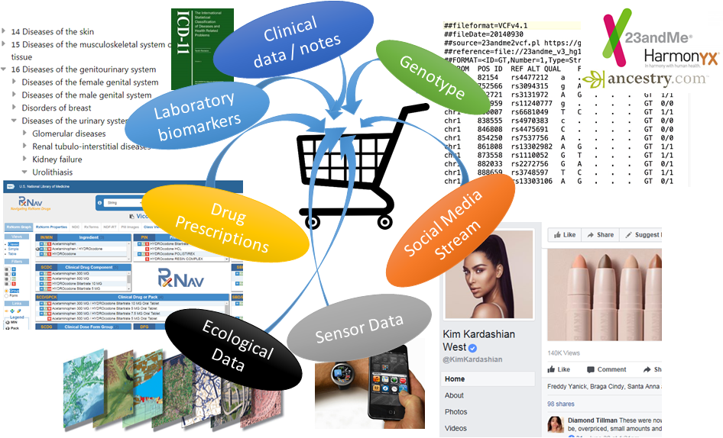
We are in Big data era
Prosperi et al.[Nature Machine Intelligence 2019]
Notes:
We are living in big data era

Slide 10
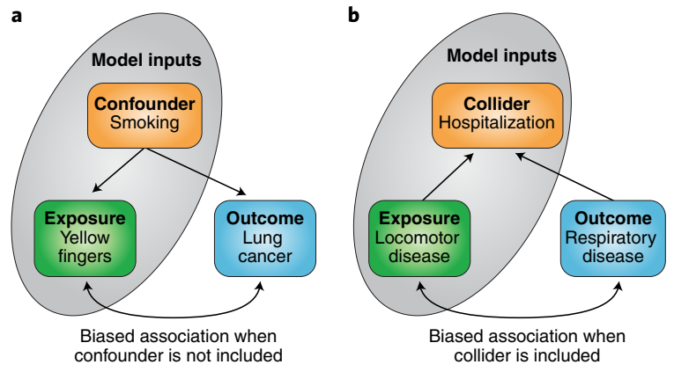
But data can be problematic
Forgetting confounders or including colliders produces biased models: predictions can still be good, but models are not causal
Notes:
In observational datasets, confounders and colliders can create biases. Confounders are Common cause of an outcome and a treatment and colliders are common effect of an outcome and an treatment.

Slide 11
Causal Inference is challenging due to counterfactuals
Treated group
P(cured|T=1) = 0.7
Control group
P(cured|T=0) = 0.2
Solutions
Randomized control trail
Propensity score matching
Inverse probability treatment weighting
Propensity score
P(T|X)=0.6
P(T|X)=0.3
P(T|X)=0.9
Drawbacks
Data rebalancing via
matching
propensity scores
Unethical, not feasible
Rest are mostly linear following
logistic regression for estimation
P(cured|T=1) = ?
P(cured|T=0) = ?
Notes:
Causal inference is estimated by Randomized control trials, IPTW, Propensity score matching

Slide 12
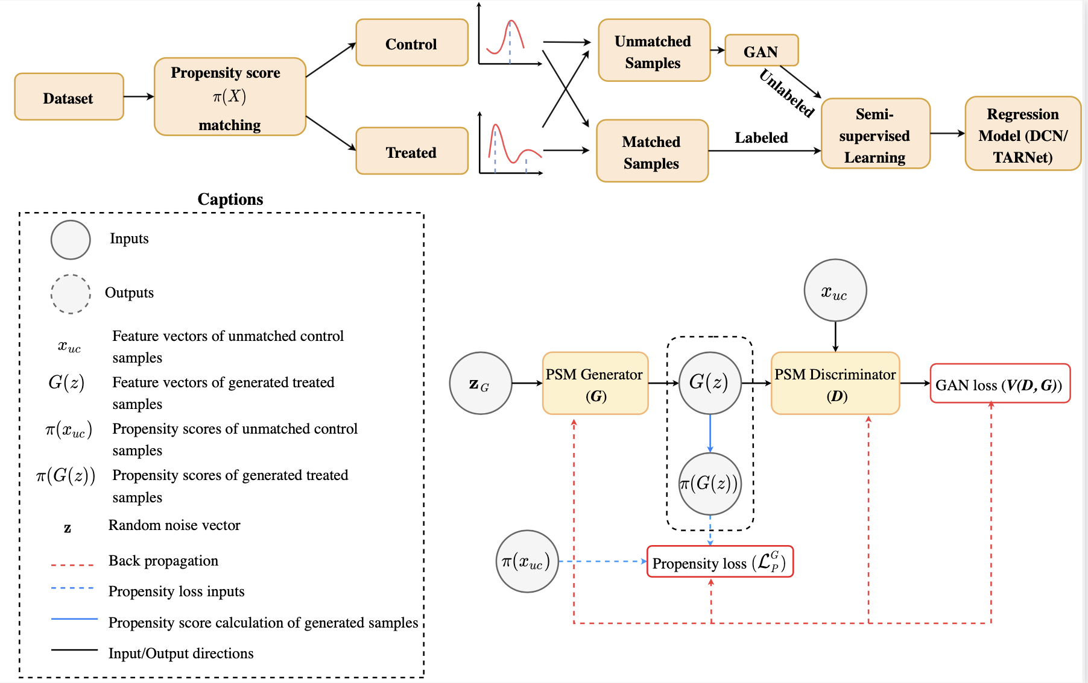
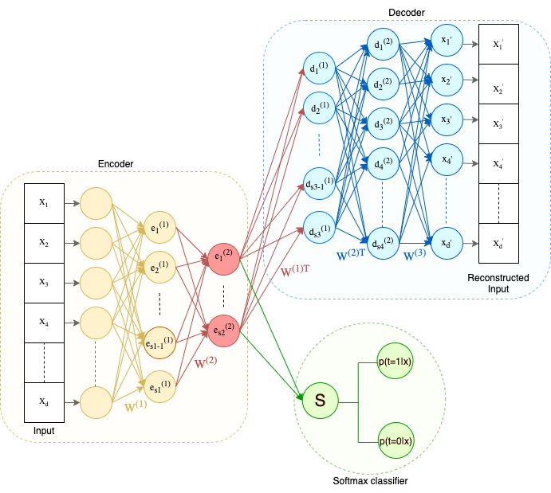
It is a deep learning era
Model non-linear treatment assignment
Handle high dimensional inputs
Provide non-linear counterfactual predictions
Ghosh et al. [Computer methods and programs in biomedicine update, 2021]
Ghosh et al. [JAMIA, 2021]
Notes:
Due to evolution of deep learning we ..

Slide 13
Our contribution
Incorporate of an underlying causal structure to approximate the data generation
process.
2. Infer the latent variables, responsible for generating data using a VAE.
Generate counterfactual outcomes using a GAN with variational information
theoretic regularization.
Estimate the individual treatment effect by minimizing the factual and
counterfactual outcomes both.
5. Utilize doubly robust regularizer for faster convergence.
Notes:
Our contribution is as follows.

Slide 14
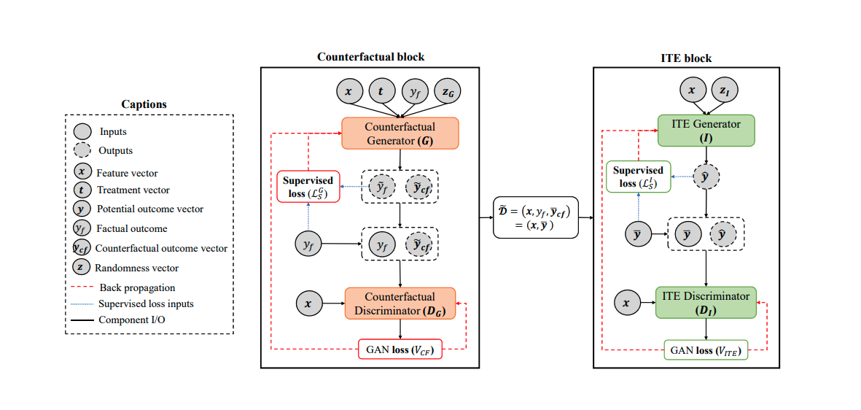
GANITE generates counterfactuals
Notes:
Our contribution is as follows.

Slide 15
Can we use latent codes?
Larsen et al. [ICML, 2016]
Dumoulin et al. [ICLR, 2017]
Notes:
Latent codes are low dimensional compressed version of inputs.

Slide 16
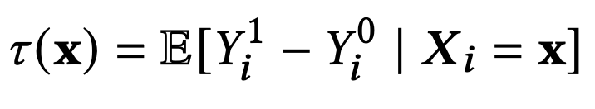
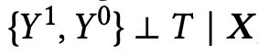
Problem formulation
Used potential outcome framework by Rubin.
The complete tuple {X_{i}, T_{i}, Y_{i} }, for i=1...N
Y_{i}⁰ and Y_{i}¹ are the potential outcomes for treatment T_{i}=0 and T_{i}=1
The ITE for the subject i with covariates X_{i} = x is defined as,
Assumption:
Followed strongly ignorable treatment assignment assumption (SITA), defined as,
Notes:
Here is the problem formulation as per Rubin.

Slide 17
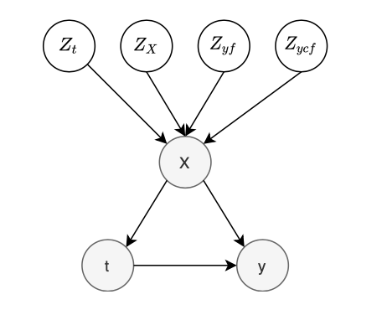
Contribution #1: Causal structure
Z: Latent space
X: Observed covariates
t: Treatment indicator
Y: Potential outcome
Notes:
Our first contribution is this causal graph. Here we assume that the covariates are generated from 4 independent random variables Z_t, Z_x, Z_yf, Z_ycf for treatment, features, factual and counterfactual outcomes respectively.

Slide 18
Contribution #2: Infer the latent variables
Back Propagation
Forward Propagation
Notes:
Here is the complete architecture of our model. The VAE block aims to infer the latent codes and the GAN block aims to generate to full tuple of factual and counterfactual outcomes. Lets decode it gradually.

Slide 19
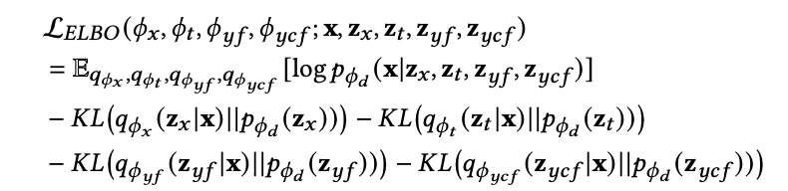
Contribution #2: Infer the latent variables
All the latent factors - z, are assumed to have a prior gaussian distributions defined as,
The variational posteriors of the inference model is defined as,
The overall ELBO function to optimize
Back Propagation
Forward Propagation
https://github.com/Shantanu48114860/DR-VIDAL-AMIA-22/blob/main/DR_VIDAL_AMIA-Supp.pdf
Notes:
In the encoder block or VAE, we want to infer the 4 latent variables z_x, z_t, z_yf, z_ycf from the observed covariate vector x. We assume that all the latent variables have a prior gaussian distribution. Next, we define the variational posteriors using the encoder as factorized gaussian distribution. We learn the mean and variances of all the gaussian distributions using the encoder block and latent codes will be sampled from these variational posterior distributions.
Lastly this is ELBO loss function that the VAE optimizes. The first term is the reconstruction loss from the decoder. All the remaining KL divergences will make sure that the variational posteriors should be as close as their priors. For details of the derivation of the ELBO loss, please refer to the appendix of our paper.

Slide 20
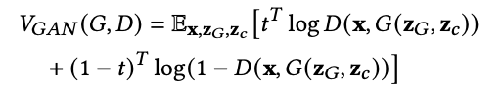
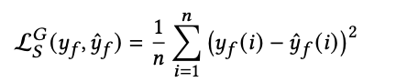
Contribution #3: Generate counterfactuals
Following GANITE, the optimization function of the GAN block,
The supervised loss is defined as,
The complete loss of the counterfactual GAN block is defined as,
Back Propagation
Forward Propagation
Notes:
Next we concatenate the latent codes to form z_c and send it to GAN to generate the factual and counterfactual outcomes.

Slide 21
Contribution #3: Generate counterfactuals
Following GANITE, the optimization function of the GAN block,
The supervised loss is defined as,
The complete loss of the counterfactual GAN block is defined as,
Maximize I(z_{c}; G(z_{G}, z_{c})) to solve the optimization function
Back Propagation
Forward Propagation
Notes:
We also aim to increase the mutual information between the learned concatenated latent code z_{c} and the generated output by the generator G(z_{G}, z_{c}).

Slide 22
Contribution #3: Generate counterfactuals
I(z_{c}; G(z_{G}, z_{c})) is harder to optimize due to p(z_{c}|x), so using a variational distribution Q(z_{c}|x) to approximate the posterior p(z_{c}|x).
The optimal discriminator and generator will be obtained by solving the following objectives
Back Propagation
Forward Propagation
https://github.com/Shantanu48114860/DR-VIDAL-AMIA-22/blob/main/DR_VIDAL_AMIA-Supp.pdf
Notes:
However, I(z_{c}; G(z_{G}, z_{c})) is intractable. Following infoGAN formulation, we utilize an auxiliary network Q to estimate the mutual information. The complete GAN loss is here

Slide 23
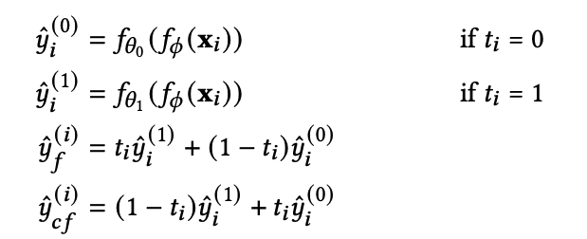
Contribution #4: Estimate ITE by minimizing the factuals and counterfactuals
The factual and the counterfactual outcomes were estimated as,
Shalit et al. [ICML, 2017]
Notes:
Once we learn, the counterfactual outcome from GAN, we append that to the tuple X, t, factual and counterfactual outcome. Next we use TARNET to optimize for both factual and counterfactual outcomes.

Slide 24
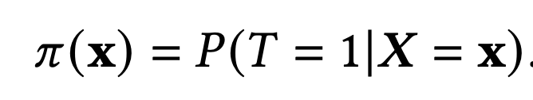
Contribution #5: Doubly robust ITE Estimation
Using propensity score, the doubly robust estimation of causal effect is defined as,
where,
The propensity score is defined as,
Jonsson et al. [American Journal of epidemiology, 2011]
Notes:
To ensure faster convergence, we incorporate the doubly robustness formulation by Jonsson. Traditionally, Logistic regression estimates it. We integrate the propensity score and an auxiliary network as neural networks. Here is this full 4 headed network to ensure the doubly robustness.

Slide 25
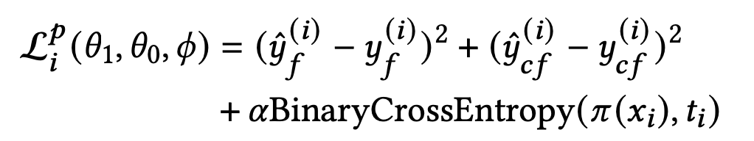
Contribution #5: Doubly robust ITE Estimation
Using propensity score, the doubly robust estimation of causal effect is defined as,
where,
The predicted loss to be optimized as,
The propensity score is defined as,
Jonsson et al. [American Journal of epidemiology, 2011]
Notes:
We add the propensity loss to the potential loss that we computed earlier.

Slide 26
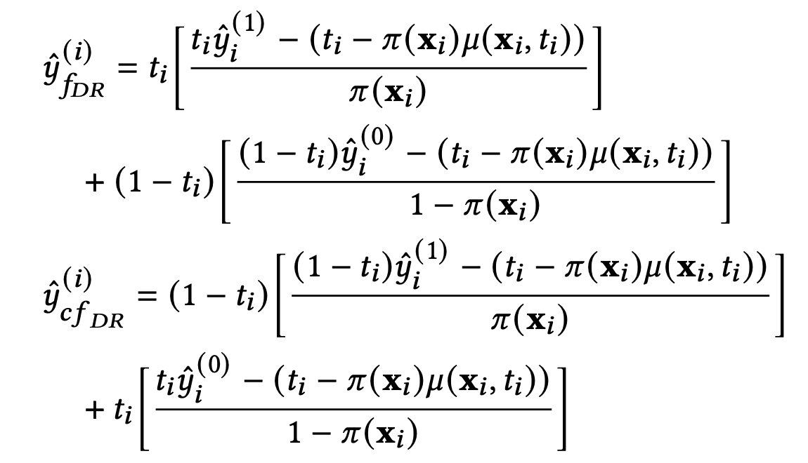
Contribution #5: Doubly robust ITE Estimation
The factual and the counterfactual doubly robust outcomes were estimated as,
Jonsson et al. [American Journal of epidemiology, 2011]
Notes:
This is how we measure the doubly robust outcomes with \pi and \mu as the propensity and auxiliary network respectively.

Slide 27
Contribution #5: Doubly robust ITE Estimation
The factual and the counterfactual doubly robust outcomes were estimated as,
The doubly robust loss is optimized as ,
Jonsson et al. [American Journal of epidemiology, 2011]
Notes:
The doubly robust loss is computed in this manner.

Slide 28
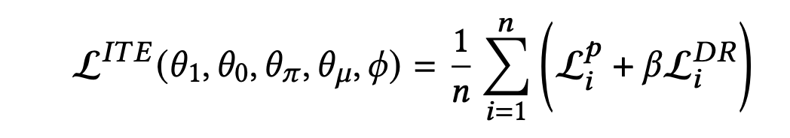
Contribution #5: Doubly robust ITE Estimation
The factual and the counterfactual doubly robust outcomes were estimated as,
The complete loss to estimate ITE to be optimized as,
The doubly robust loss is optimized as ,
Jonsson et al. [American Journal of epidemiology, 2011]
Notes:
Finally we minimize the weighted loss of potential and doubly robust loss to optimize the network.

Slide 29
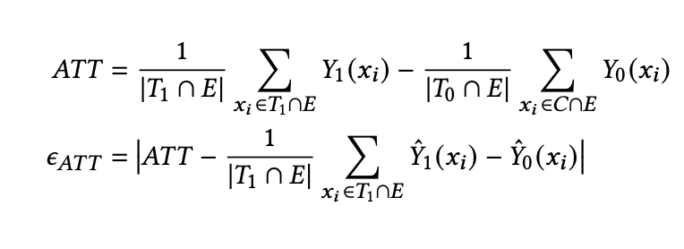
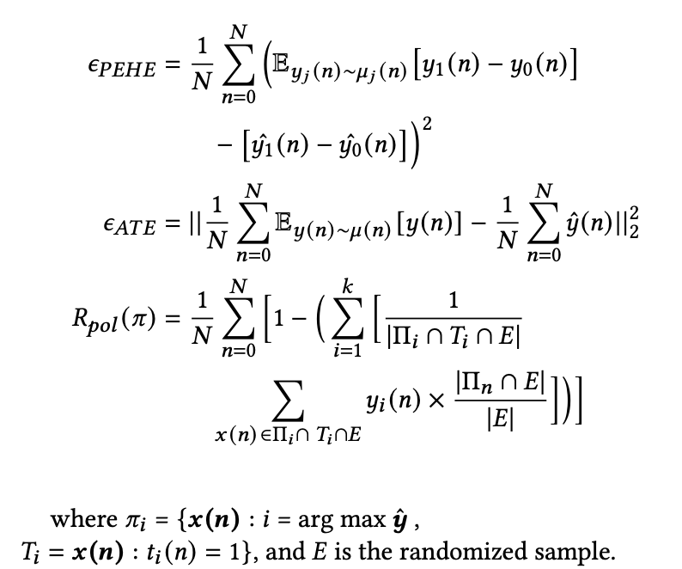
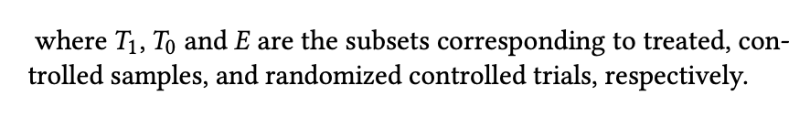
Performance metrics
Notes:
We measure the performance metrics interms of error onAvg treatment on treated, precision estimation of heterogenous effect, policy risk and avg treatment effect.

Slide 30
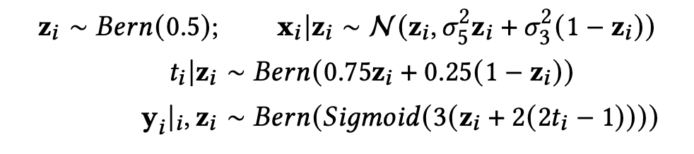
Results – Synthetic datasets 1
Comparison of the performance (ATE) of DR- VIDAL vs. all other models on samples from the generative process of Synthetic dataset 1 - sample size {1000, 3000, 5000, 10000, 30000}
Louizos et al. [Neurips, 2017]
Notes:
The first result is on the basis of the simulated data from CEAVE. Even though, the data generation process of CEVAE is significantly different DR-VIDAL with doubly robustness performs the best for estimating the error of Average treatment effect. The Red plot indicates this.

Slide 31
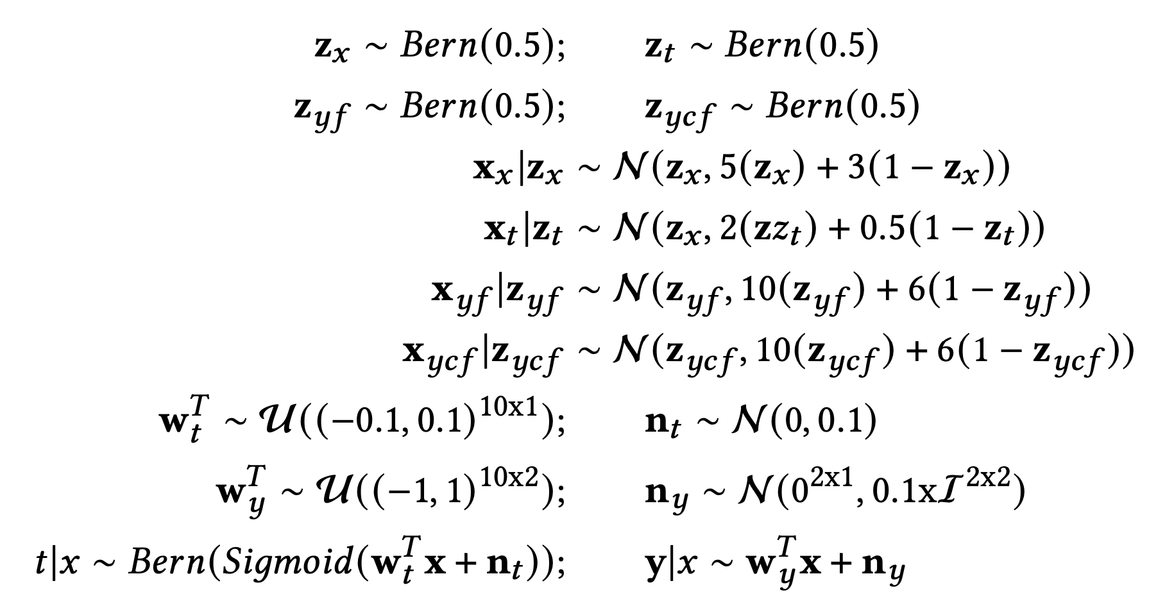
Results – Synthetic datasets 2
Performance comparison (PEHE) of GANITE vs. DR-VIDAL
Sample sizes: {1000, 3000, 5000, 10000, 30000}
Notes:
We also generated the simulated data based on our model and compares the PEHE metric with GANITE. Here also DR-VIDAL with the doubly robustness performs the best.

Slide 32
Results – Synthetic datasets 2
Performance comparison (PEHE) of GANITE vs. DR-VIDAL
Sample sizes: {1000, 3000, 5000, 10000, 30000}
Notes:
And we also perform the same experiment to estimate log(PEHE) metric.

Slide 33
Results – Real world datasets
IHDP
Jobs
Twins
Notes:
For real world data, we use IHDP, JOBs and Twins

Slide 34
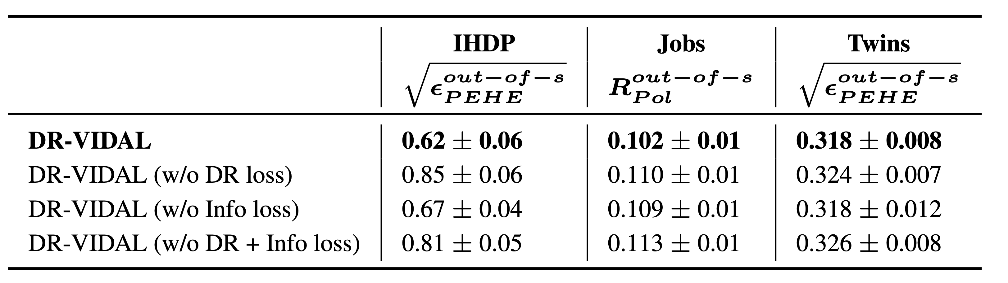
Results – Ablation study
Notes:
We perform the ablation study and check that DR-VIDAL with doubly robust loss performs the best for all the datasets.

Slide 35
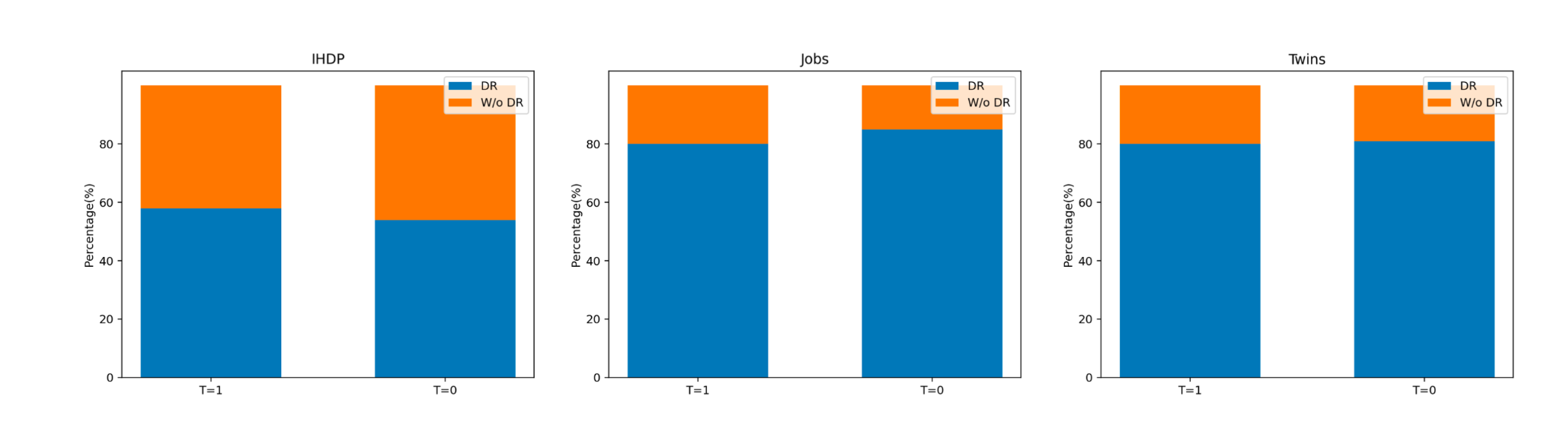
Results – correct classification of factual outcomes
Notes:
We also, tried to estimate the marginalized factual outcomes for t=0 and t=1. In all the datasets DR-VIDAL with doubly robustness, performs better than its non-doubly robustness variants.

Slide 36
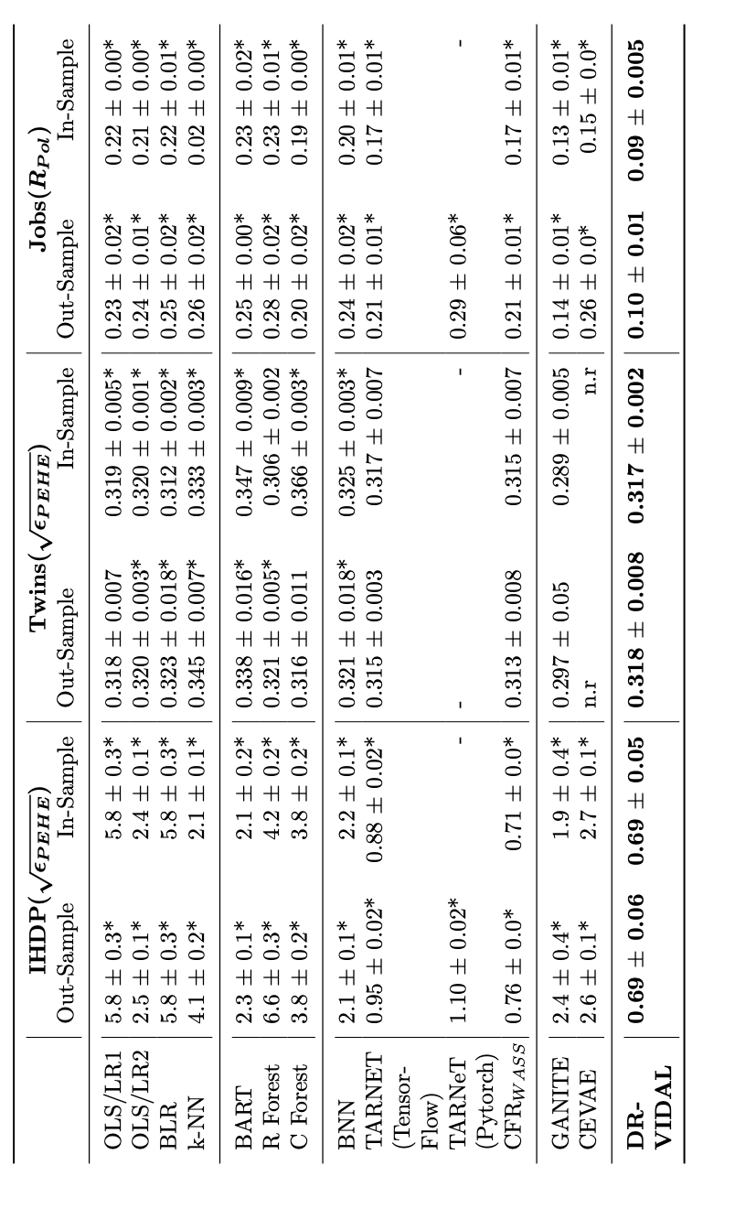
Results – PEHE and policy risk (mean ± st.dev)
Notes:
Finally this the comprehensive comparison of performances in terms of PEHE and policy risk of DR-VIDAL with the other models. For IHDP and JOBs DR-VIDAL outperforms other models. For Twins, DR-VIDAL is comparable with others except GANITE.

Slide 37
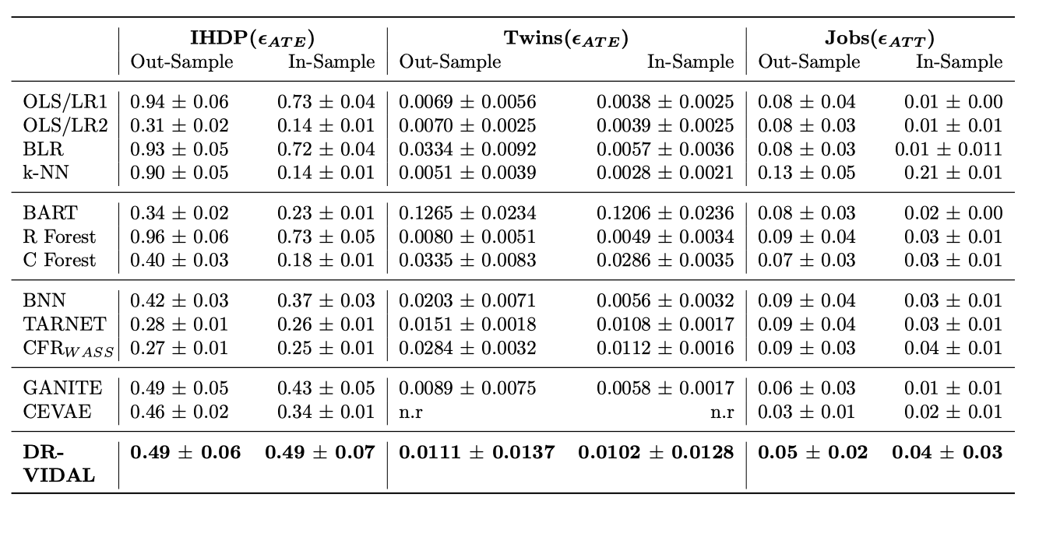
Results – ATE and ATT (mean ± st.dev)
Notes:
This table compares the performance of DR-VIDAL with other models in terms of the error in average treatment effect and average treatment effect on the treated. DR-VIDAL shows comparable performance compared to other.

Slide 38
Conclusion
Beats the performance of previous generative models on synthetic datasets
Comparable performance on real-world datasets.
Code: https://github.com/Shantanu48114860/DR-VIDAL-AMIA-22/
Notes:
So in conclusion, we incorporated a causal graph to estimate individual treatment effect. We utilize a VAE to infer latent variables and GAN to estimate counterfactual outcomes. Finally, we utilize doubly robustness to tarnet with both factual and counterfactual outcomes for faster convergence. Refer to the github link for the code.

Slide 39
Future directions
1. Causal Graph is too simple.
2. How to enforce strict disentanglement?
3. Instead of Variational Information Maximization, what about Variational Information Bottleneck Layer?
4. TARNET, DRAGONNET, DCN-PD, ITE block as a downstream model instead of the Doubly robust treatment estimator.
6. More realistic data from News-8 or MIMIC-II(EBB).
Notes:
Our model has some limitations

Slide 40



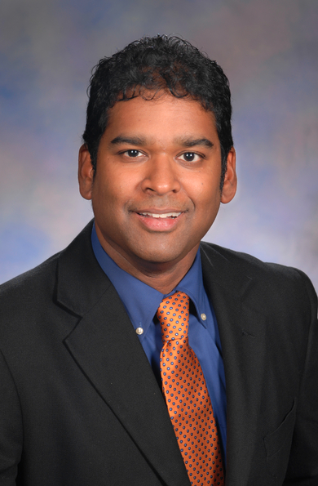
Acknowledgement
Funded by NIH awards R21CA245858, R01CA246418, R56AG069880, R01AG076234, R01AI145552, R01AI141810, and NSF 2028221

Slide 41
Thank you!
Email me at: shg121@pitt.edu
Notes:
Thank you.

